Slide 1
MGC Yamaha Mixer and Zoom Guide

Slide 2
How To Fix Quet USB Output on Yamaha MG10XU (Part 1)
Plug your microphone into any channel
Turn on Phantom Power if you’re using a condenser microphone (Optional)
Turn the Level (bottom white knob) up to the triangle position. (Important, check the picture on the following page)
Increase the gain until the meter goes up to 0 (without going over) when you are speaking normally
Append (MGC_Audio) to the end of zoom name to avoid being muted.
Adjust the stereo output (bottom right) up or down to bring your speakers to your desired volume.

Slide 3
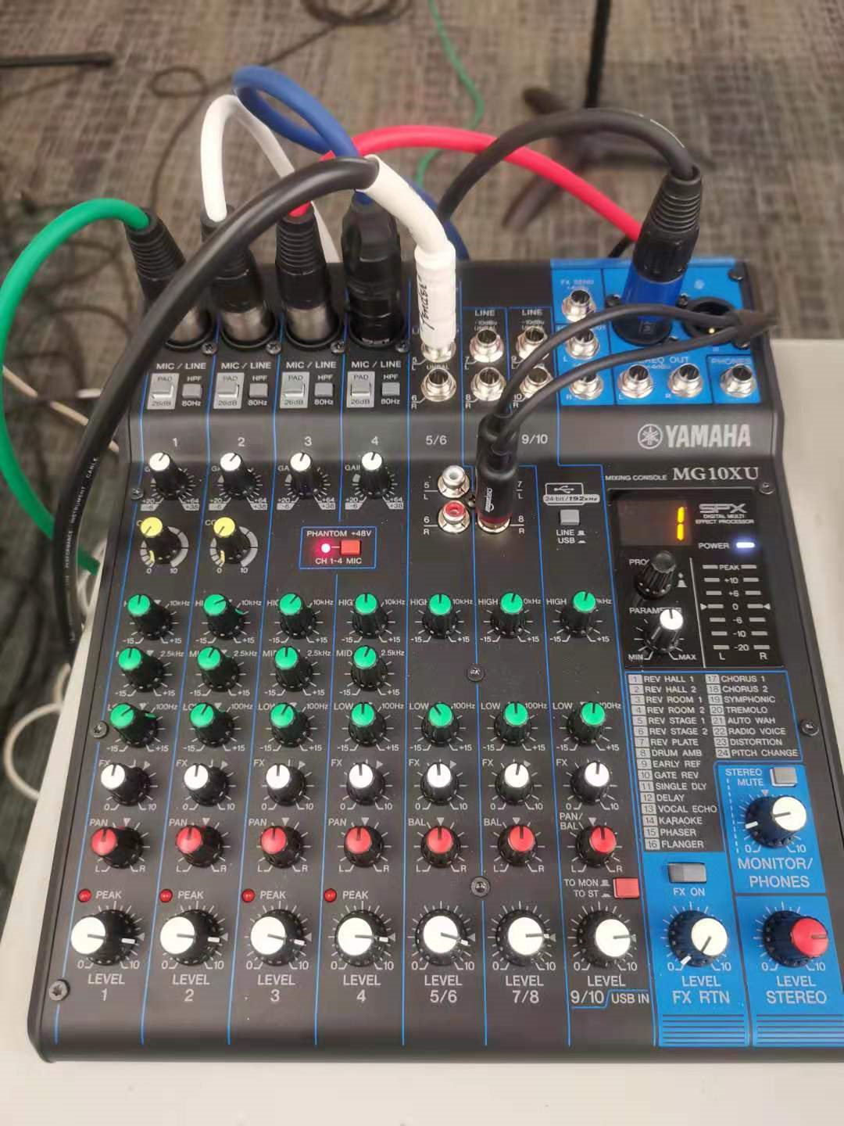
Gain
Triangle position

Slide 4
How To Fix Quet USB Output on Yamaha MG10XU (Part 2)
If the meter is hitting 0 when you speak normally, your USB output will be sending a signal that is as strong as it should be for your live stream or recording. You don’t want more level than this with a digital signal going to your recording device/computer.
Required - 8 min Yamaha mixer setup video: https://www.youtube.com/watch?v=NYQKAvPDatg
***********************************************************************************Optional - Mixer tutorial (beginner):
https://www.youtube.com/watch?v=EhFEGeeg00g&list=PLyFU6WeNzu3_EHEzEfkYClUVKYKnqX2TX&index=1

Slide 5
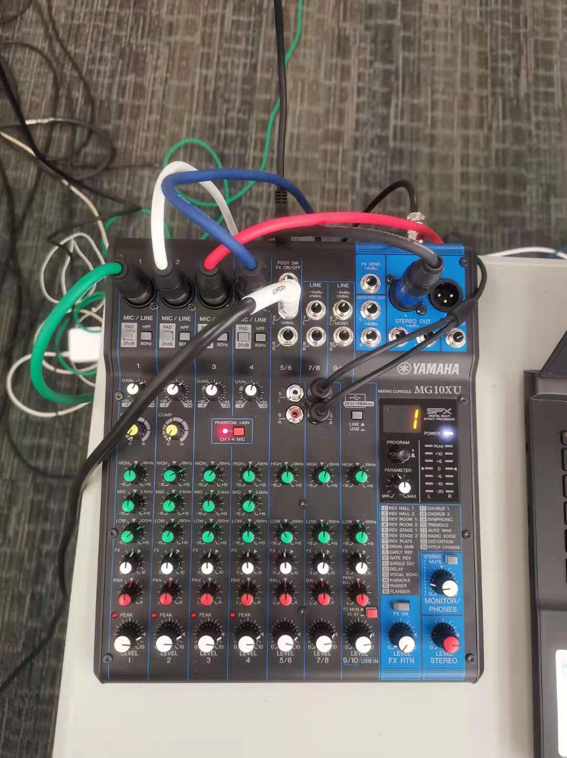
Audio interface cable (printer cable), connect to PC usb port to output audio to Zoom meeting.
Connect to speaker
Guitar Cable
Connect to Presenter’s PC with audio jack, so the online audio can be sent to mixer, then to the speaker.

Slide 6
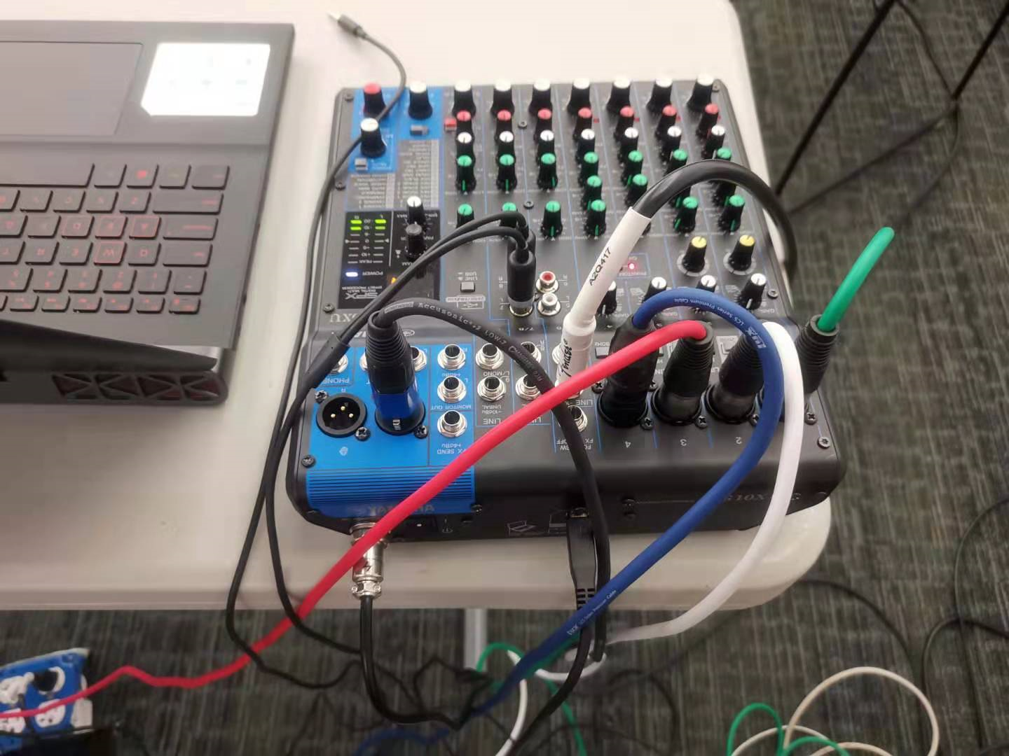
Printer Cable, connect to pc, to output audio to zoom

Slide 7
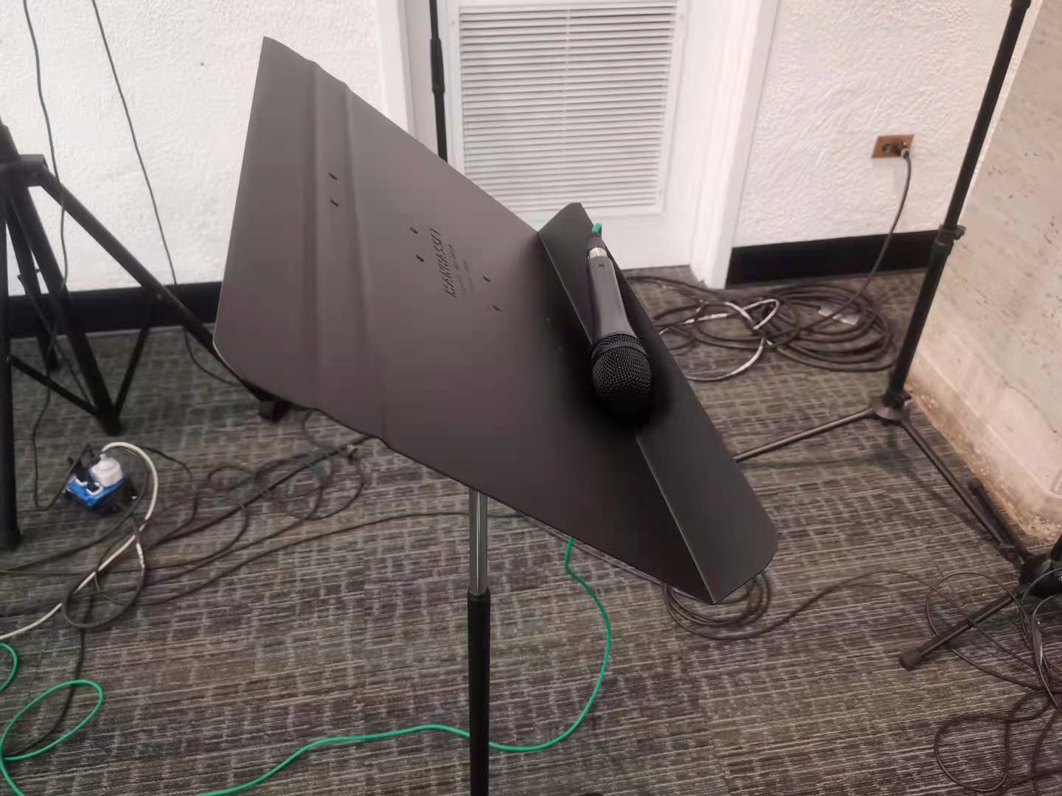

Slide 8
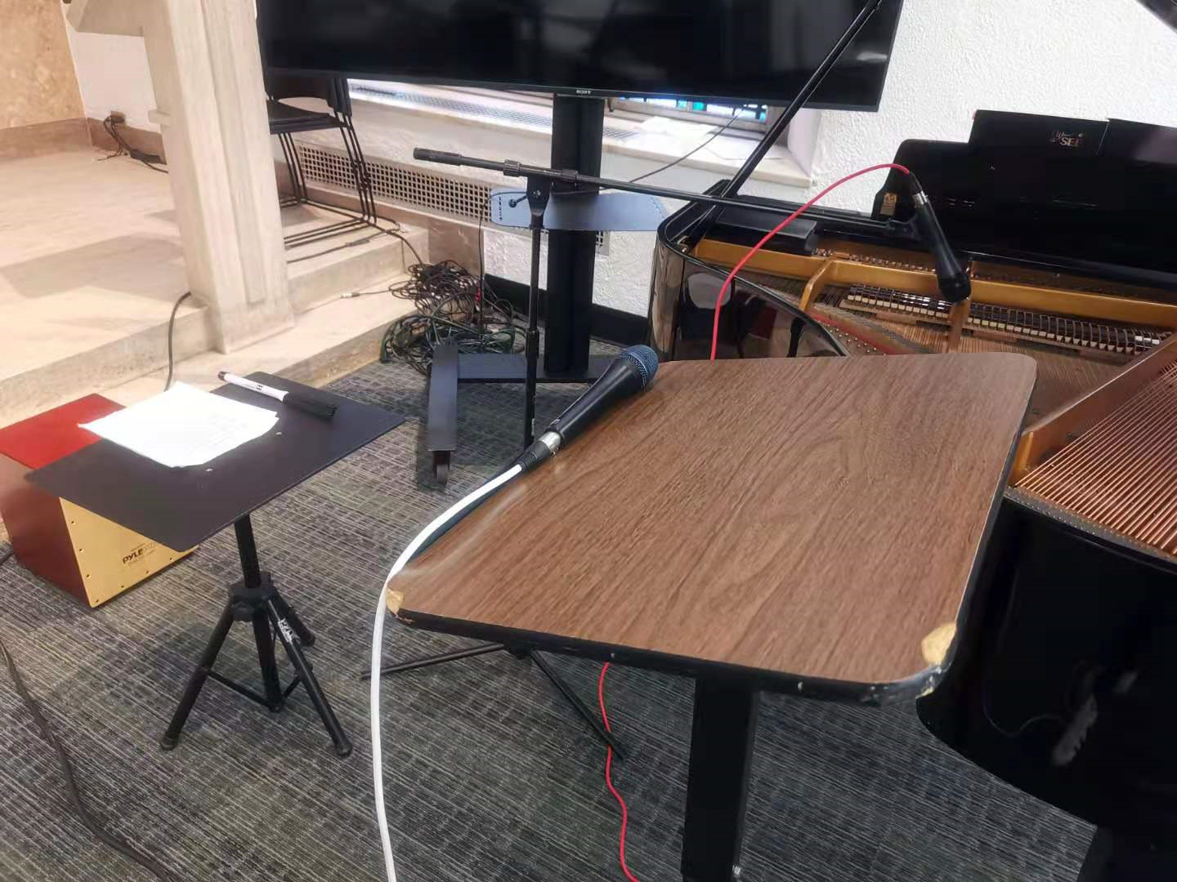

Slide 9
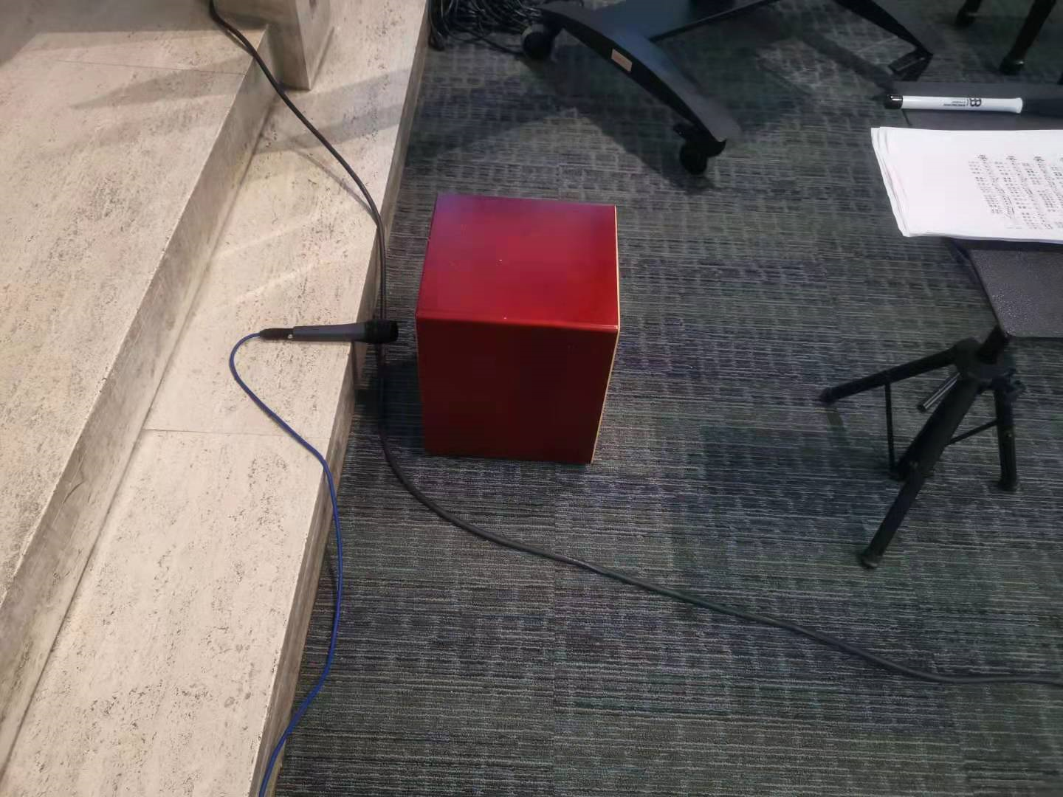

Slide 10
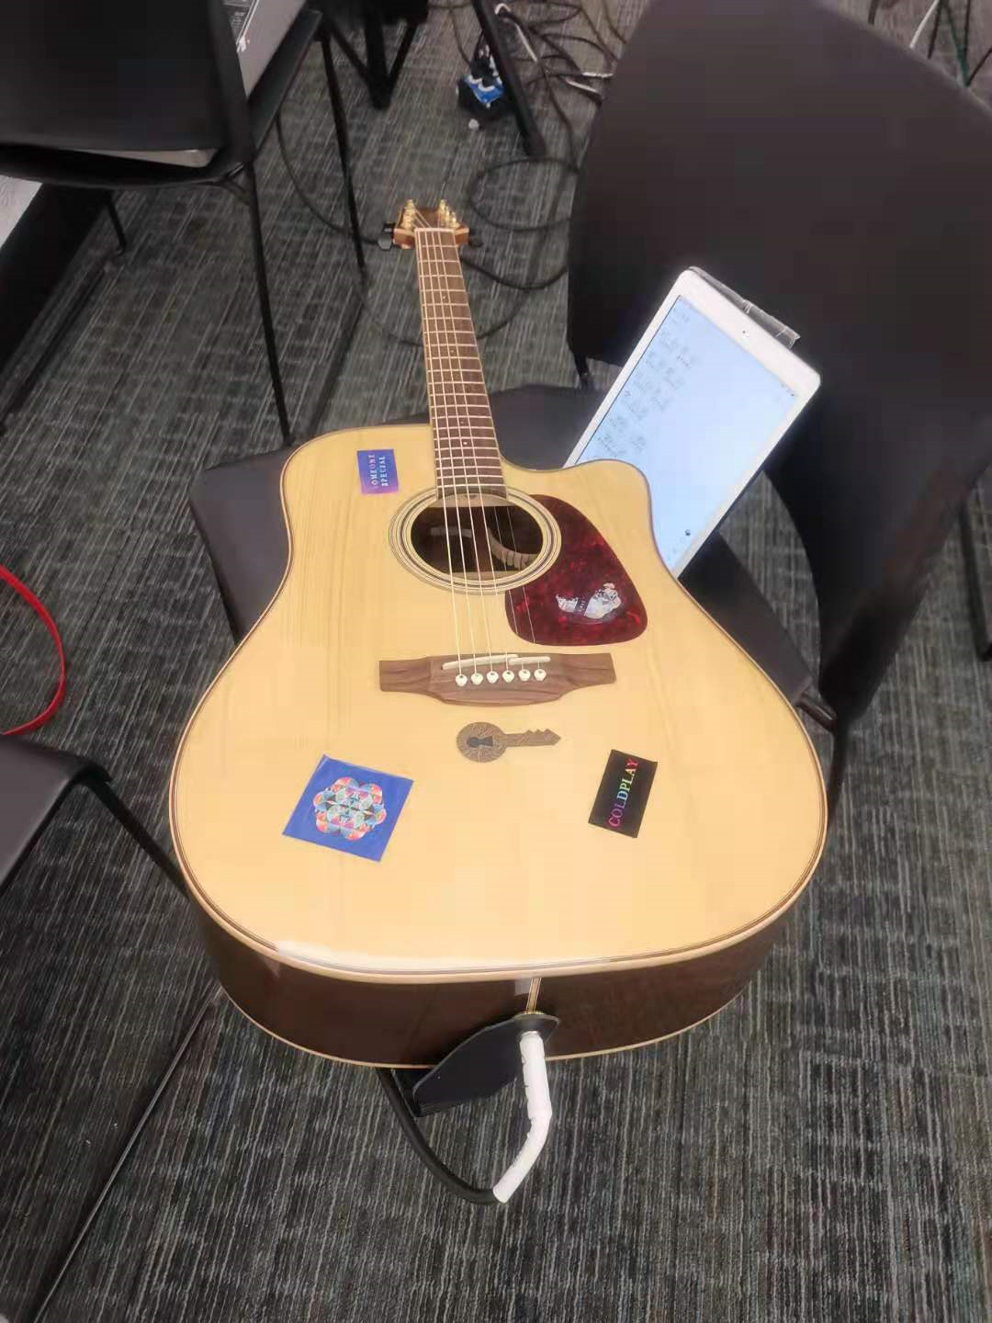

Slide 11
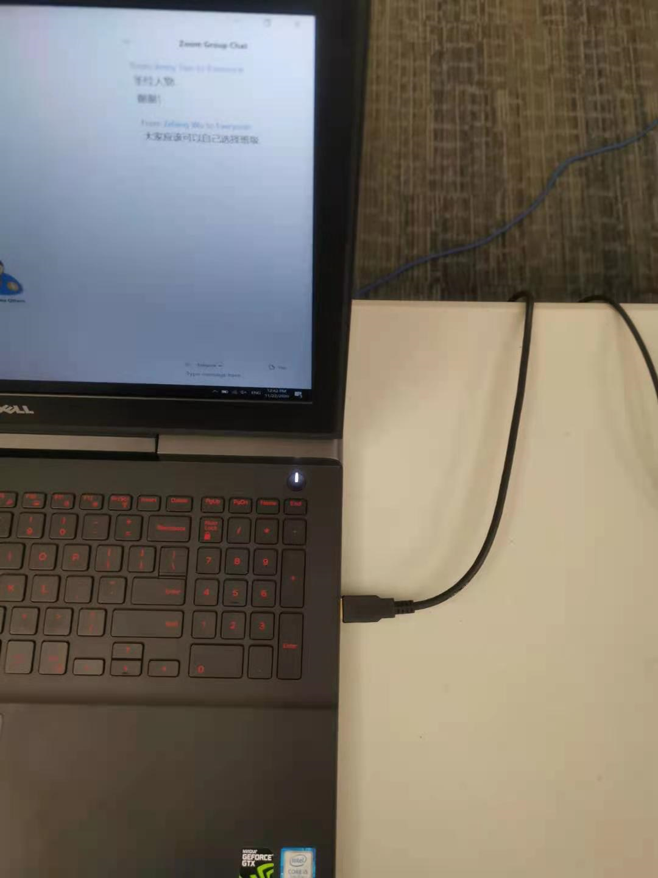
Audio interface cable (printer cable), connect to the USB port

Slide 12
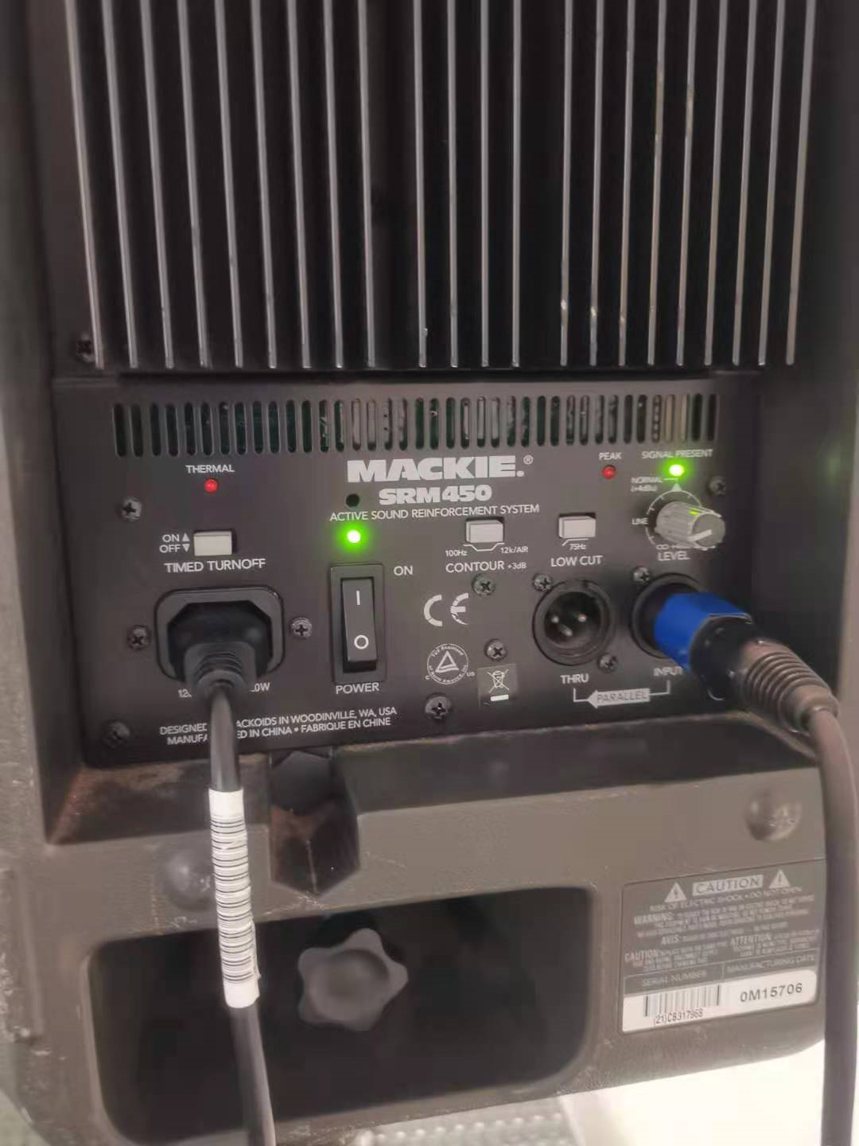
After setting up the mixer for Zoom, the audio in chapel may be too loud, adjust the speaker volume to the appropriate level before worship.

Slide 13
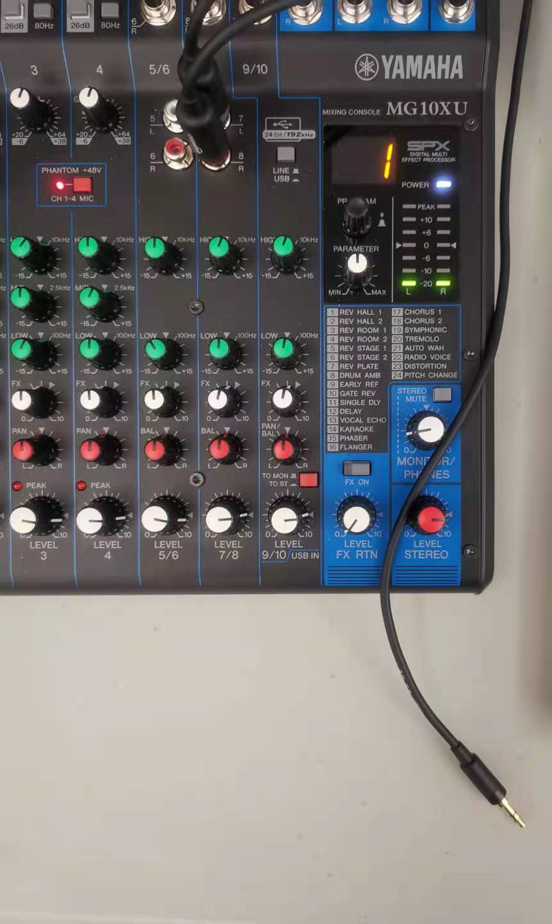
Send Zoom audio to speaker

Slide 14
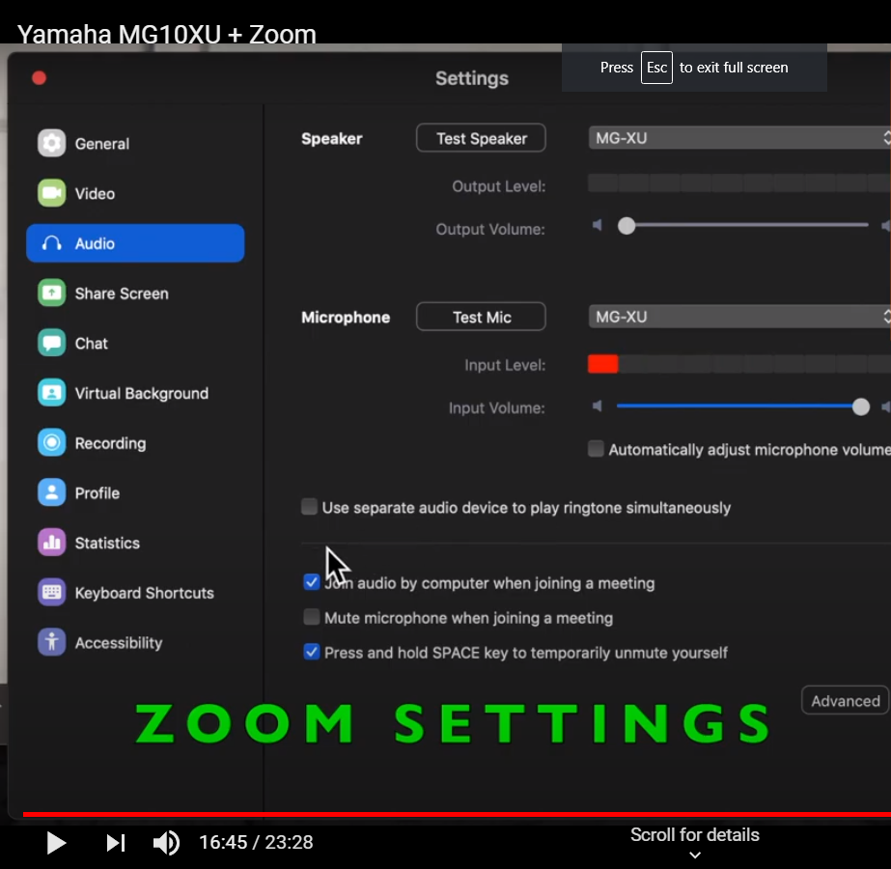
Zoom audio setup (Part 1)
Don’t select “MG-XU”, we’ll use presenter’s PC to send audio to chapel speaker.
Select MG-XU (Yamaha mixer)
Unchecked this box

Slide 15
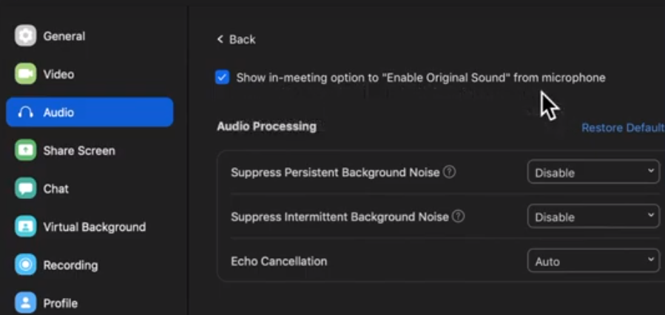
Part 2: Zoom audio setting => Advanced setting

Slide 16
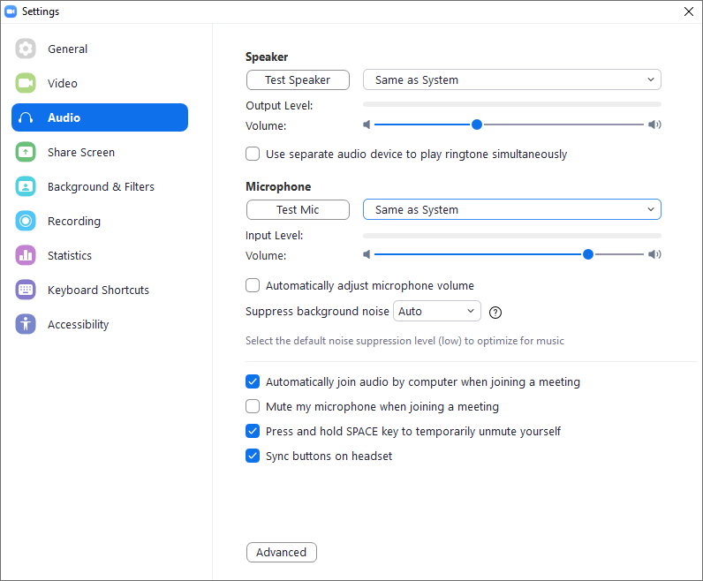
Presenter PC audio setup
Select “MG-XU”(Yamaha mixer) to send audio to mixer, then to chapel speaker.

