Slide 1
Ephesians
The Supremacy of Christ and His Reconciling Work

Slide 2
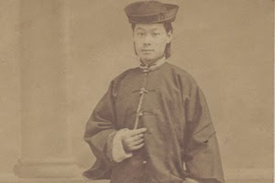
Wong
Chin Foo
(1847-1898)

Slide 3
Wong Chin Foo (1847-1898)
“As residents of the United States, we claim a common manhood with all other nationalities, and believe we should have that manhood recognized according to the principles of common humanity and American freedom.”
"We, therefore, appeal for an equal chance in the race of life in this our adopted home – a large number of us have spent almost all our lives in this country and claim no other but this as ours. Our motto is: 'Character and fitness should be the requirement of all who are desirous of becoming citizens of the American Republic.'”

Slide 4
1963
"I have a dream that my four little children will one day live in a nation where they will not be judged by the color of their skin but by the content of their character."

Slide 5
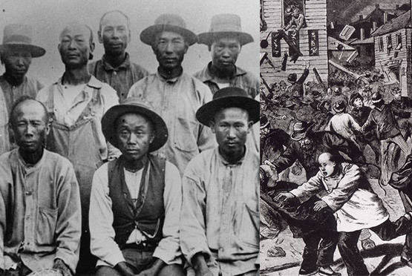
The 1871 Chinese Massacre

Slide 6
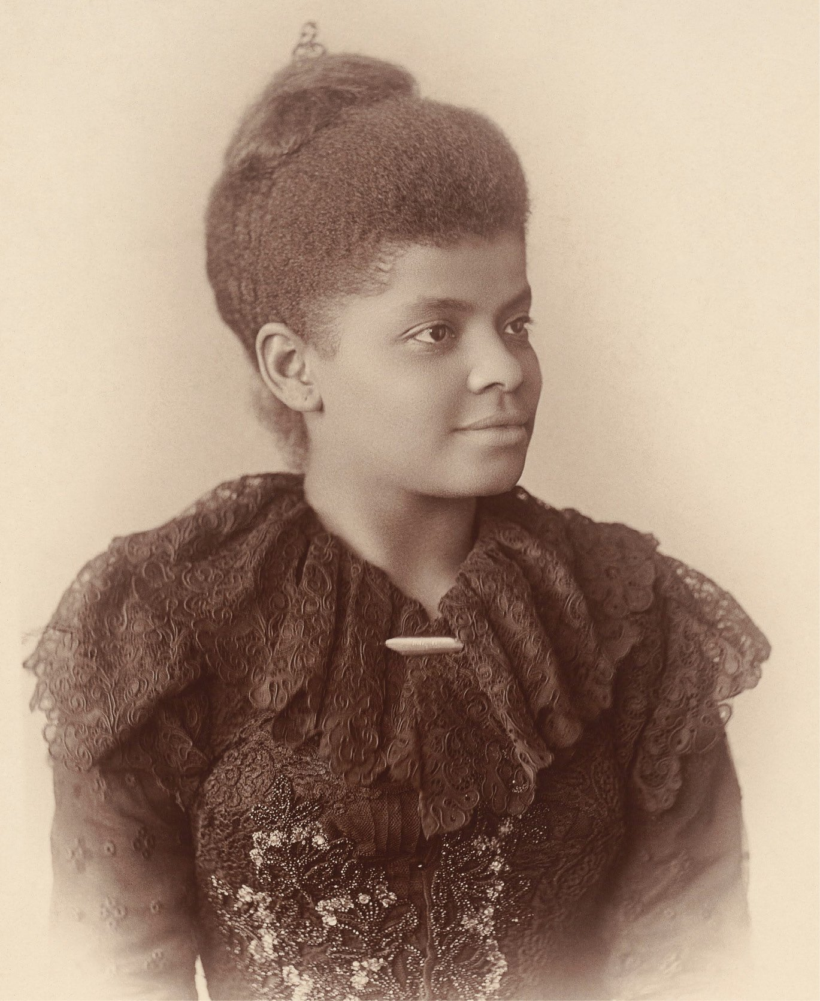
Ida B. Wells
(1862-1931)

Slide 7
Ida B. Wells (1862-1931)
“Princess of the Press”

Slide 8
Ida B. Wells (1862-1931)
Journal Entry
“I felt lifted up and I thank God I opened my mouth and told of His wonderful mercies to me and my heart overflowed with thankfulness,” she wrote after one worship service.
Journal Entry
“And if I did nothing, sacrificed nothing in return for all that has been done for me, I could not expect his blessing and sanction. Help me and bring success to my efforts I pray.”

Slide 9
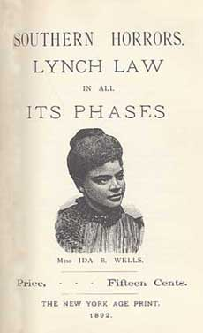
Ida B. Wells (1862-1931)

Slide 10
Eph 4:11-13
11 So Christ himself gave the apostles, the prophets, the evangelists, the pastors and teachers, 12 to equip his people for works of service, so that the body of Christ may be built up 13 until we all reach unity in the faith and in the knowledge of the Son of God and become mature, attaining to the whole measure of the fullness of Christ.

Slide 11
Eph 4:11 - APEST
Apostolic Gift
Prophetic Gift
Evangelistic Gift
Pastoring/Shepherding Gift
Teaching Gift

Slide 12

5Q: Reactivating the Original Intelligence and Capacity of the Body of Christ by Alan Hirsch

Slide 13
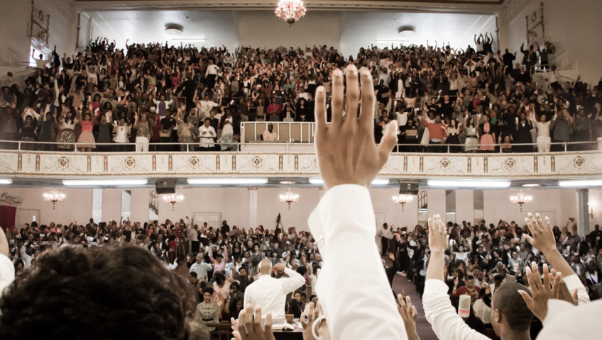
First Corinthian Baptist Church
1912 Adam Clayton Powell Jr, Blvd (at the corner of 116th street)

Slide 14
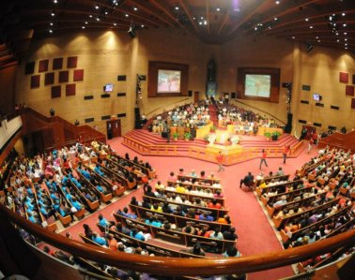
The Greater Allen A.M.E. Cathedral of New York in Jamaica, Queens

Slide 15
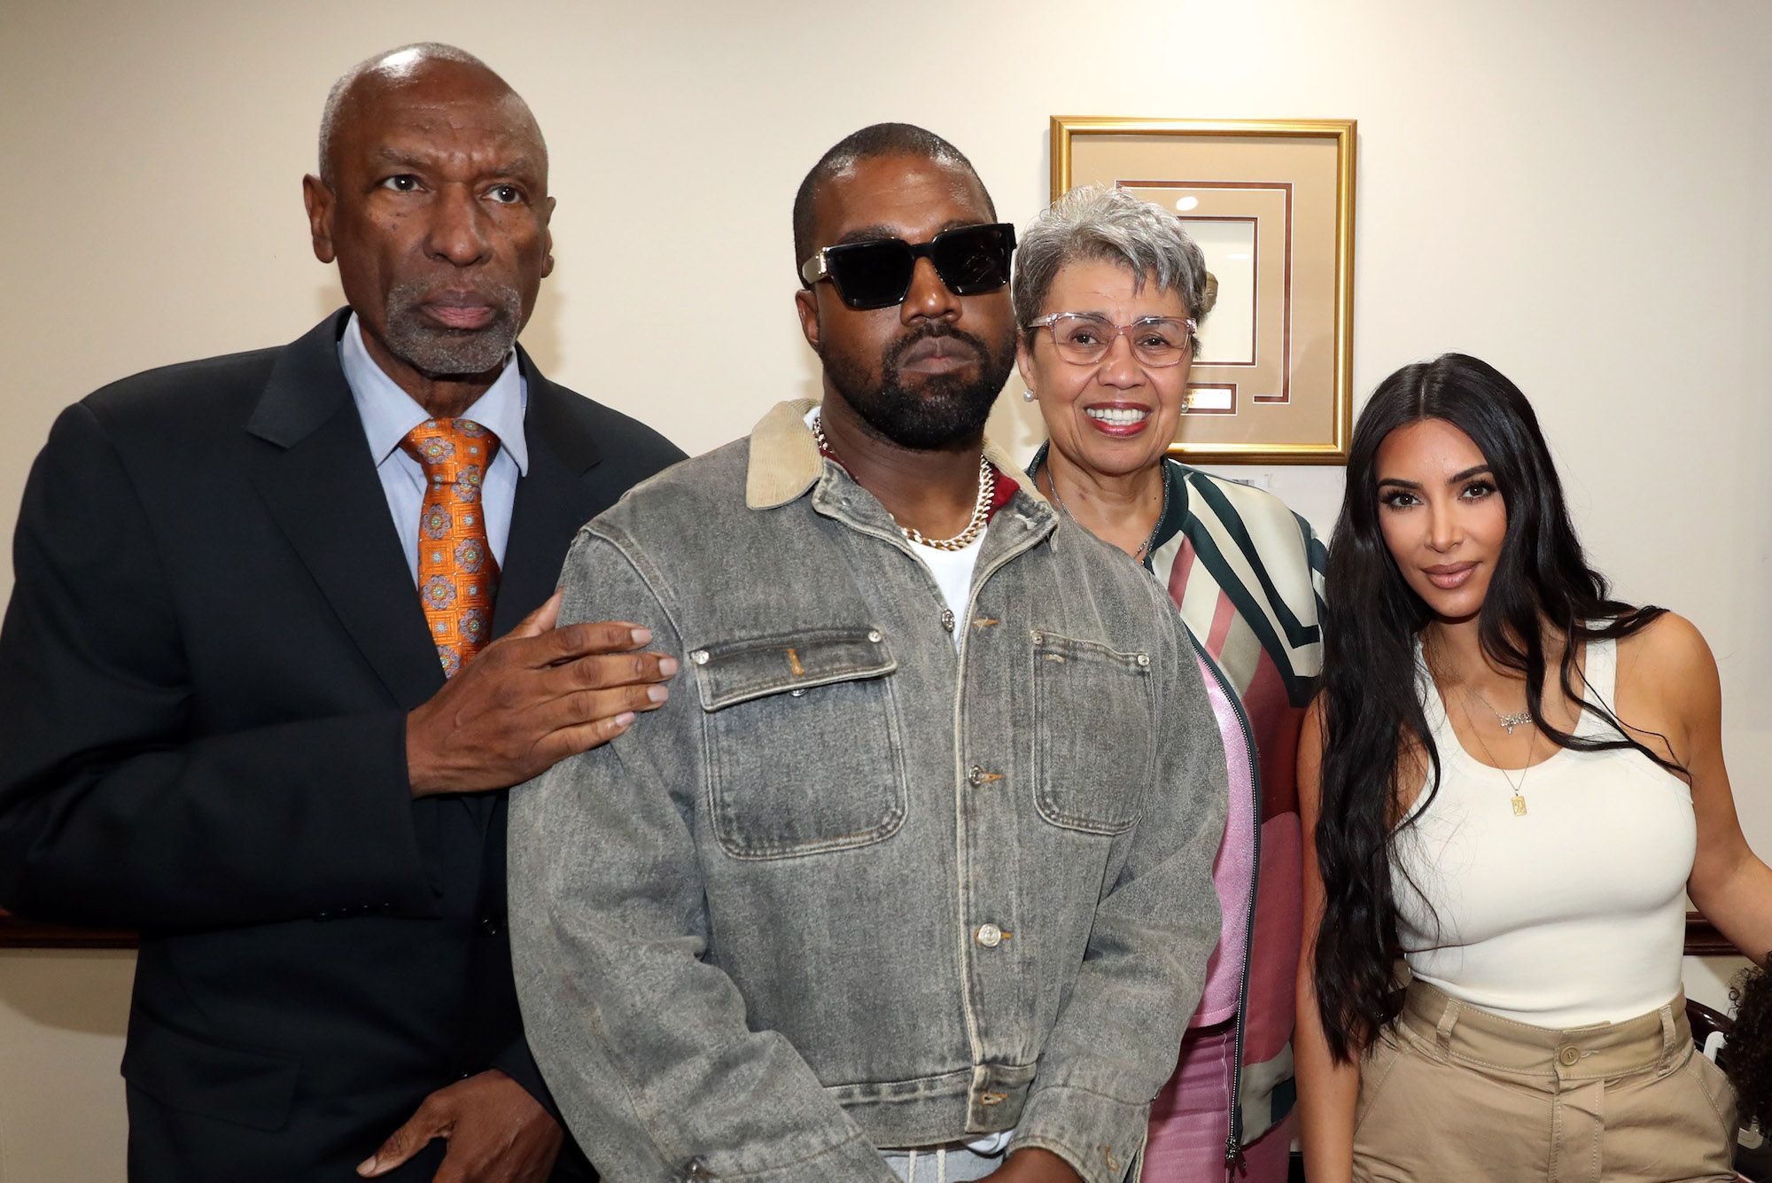
The Greater Allen A.M.E. Cathedral of New York in Jamaica, Queens

Slide 16
Eph 2:14-16
14 For he himself is our peace, who has made the two groups one and has destroyed the barrier, the dividing wall of hostility, 15 by setting aside in his flesh the law with its commands and regulations. His purpose was to create in himself one new humanity out of the two, thus making peace, 16 and in one body to reconcile both of them to God through the cross, by which he put to death their hostility.

Slide 17

Jack Roosevelt Robinson &
Wesley Branch Rickey

Slide 18
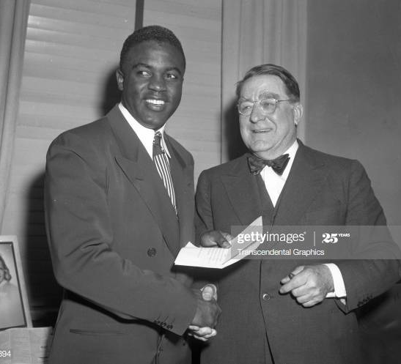
Jackie Robinson & Branch Rickey

Slide 19
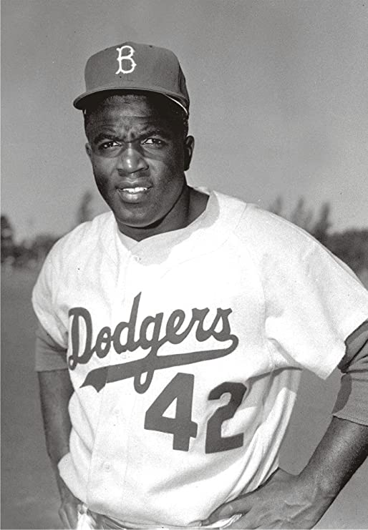
Jackie Robinson

Slide 20

Harrison Ford & Chadwick Boseman

Slide 21


Slide 22
Matthew 5:38–41 in the King James Version states:
Jesus said, Ye have heard that it hath been said, An eye for an eye, and a tooth for a tooth: But I say unto you, That ye resist not evil: But whosoever shall smite thee on thy right cheek, turn to him the other also. And if any man will sue thee at the law, and take away thy coat, let him have thy cloak also. And whosoever shall compel thee to go a mile, go with him twain.

Slide 23
Eph 6:10-12
10 Finally, be strong in the Lord and in his mighty power. 11 Put on the full armor of God, so that you can take your stand against the devil’s schemes. 12 For our struggle is not against flesh and blood, but against the rulers, against the authorities, against the powers of this dark world and against the spiritual forces of evil in the heavenly realms.

Slide 24
Eph 1:1-14
God the Father planned salvation.
God the Son purchased salvation.
God the Holy Spirit presented salvation.

Slide 25
Book of Ephesians
Chap 2-3 - God reconciles all races making one new humanity.
Chap 4 - God reconciles and unites the church.
Chap 5-6 - God reconciles the family: husband and wife, parents and children, and even master & slave.

Slide 26
Eph 4:25-27
25 Therefore each of you must put off falsehood and speak truthfully to your neighbor, for we are all members of one body. 26 “In your anger do not sin”: Do not let the sun go down while you are still angry, 27 and do not give the devil a foothold.

Slide 27
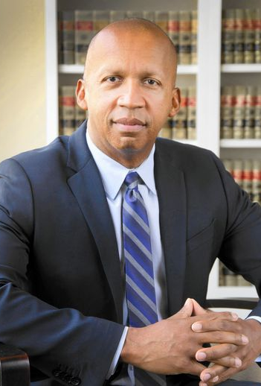
Bryan Stevenson, MPP/JD 1985
LLD 2015

Slide 28
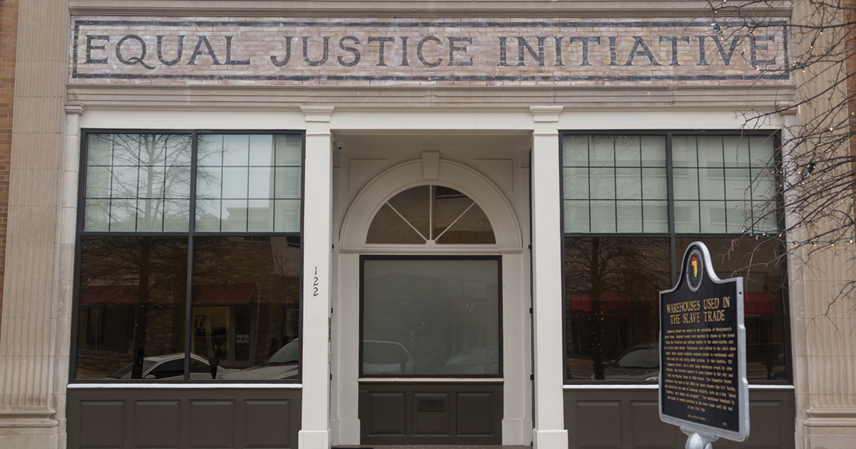
Montgomery, Alabama

Slide 29
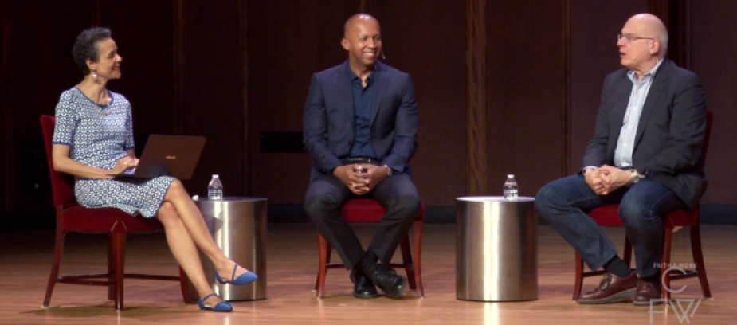
Bryan Stevenson & Tim Keller (2016)

Slide 30

https://www.youtube.com/watch?v=q7MxXxFu6fI

Slide 31
Eph 1:9-10
9 he made known to us the mystery of his will according to his good pleasure, which he purposed in Christ, 10 to be put into effect when the times reach their fulfillment—to bring unity to all things in heaven and on earth under Christ

Slide 32
Eph 1:22
22 And God placed all things under his [Jesus] feet and appointed him to be head over everything for the church

